Slide 1


Welcome Our Presentation

Slide 2
Presentation Name Student Record Management System

Slide 3
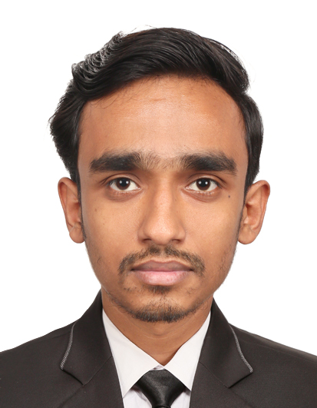
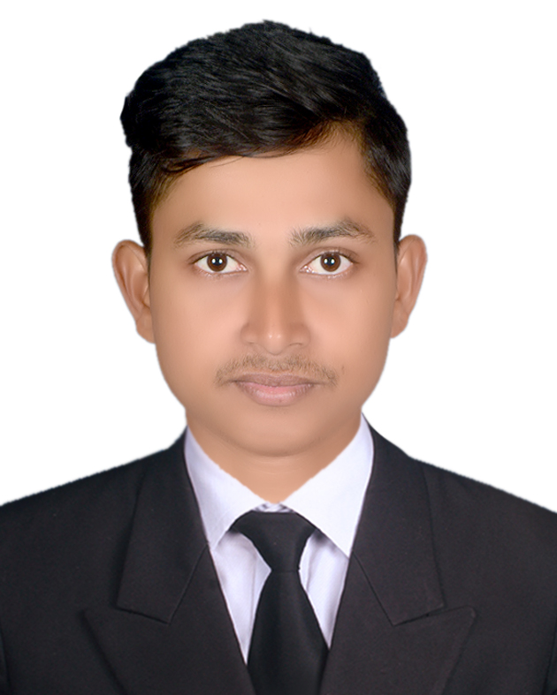
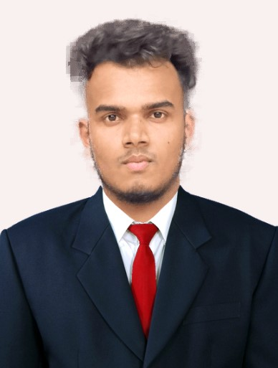
Our Teem Member
ID: 42250102263
Name: Arju Shaikh
Department: ECSE
Section: 2C Semester: 2nd
Northern University Bangladesh
ID: 42250102241
Name: Sabbir Hossain
Department: ECSE
Section: 2C Semester: 2nd
Northern University Bangladesh
ID: 42250102240
Name: Rezwan Ahmad
Department: ECSE
Section: 2C Semester: 2nd
Northern University Bangladesh

Slide 4


Project Name
Student Record Management System
LOG IN
User name
Password

Slide 5
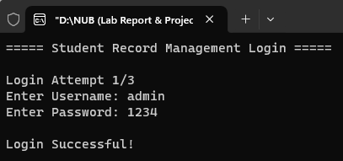
Login Page
System Design
Screenshot

Slide 6




Project Name
Student Record Management System
Add Student Info
Display Students
Search Student
Delete Student
Exit

Slide 7
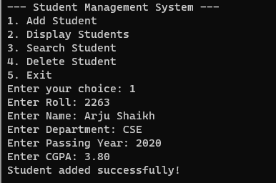
Add Student info
System Design
Screenshot

Slide 8
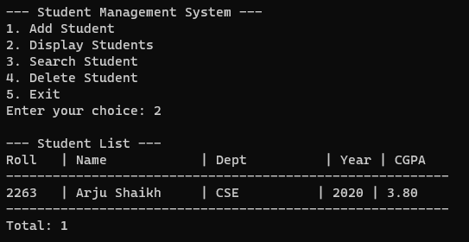
display Student's info
System Design
Screenshot

Slide 9
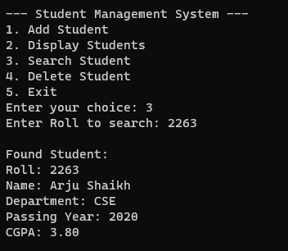
search Student's info
System Design
Screenshot

Slide 10
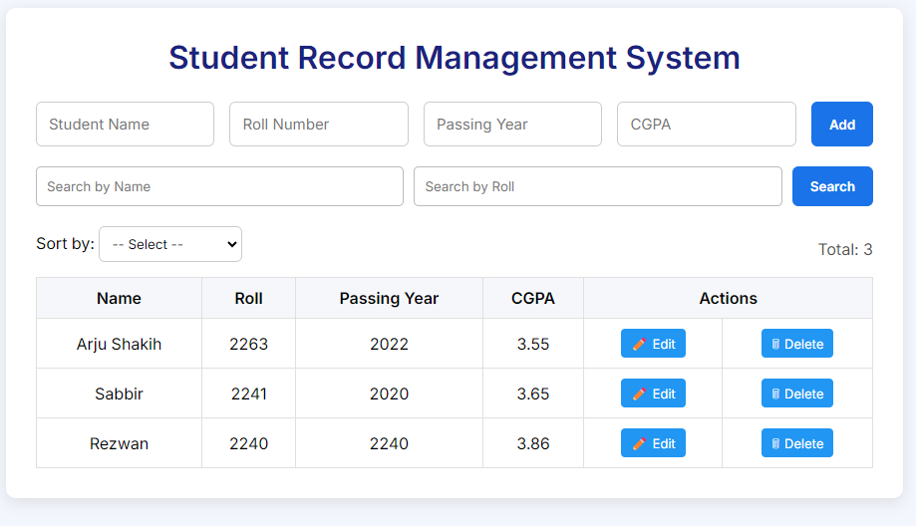
Design (HTML , CSS & Js) Add option

Slide 11
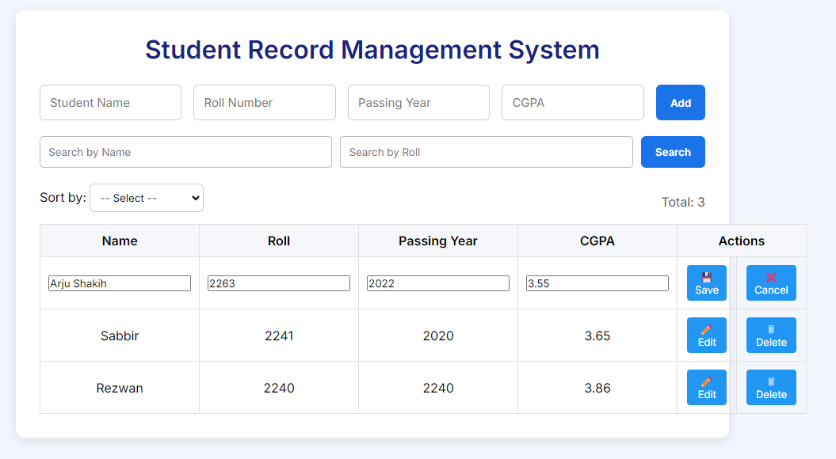
Design (HTML , CSS & Js) Edit Option

Slide 12
Thank You
@EVERYONE

